Slide 1

Transportation Model & Assignment Model
SCHOOL OF DATA SCIENCE AND FORECASTING
DEVI AHILYA VISHWAVIDYALAYA, INDORE

Slide 2
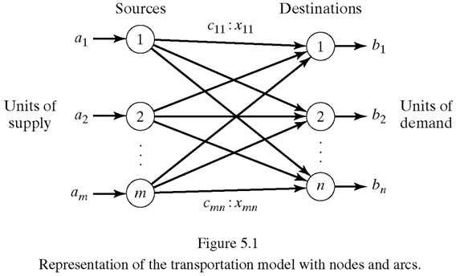
Transportation Model
The transportation model is a special class of the LP problem.
It deals with shipping a commodity from sources (e.g. factories) to destinations (e.g. warehouses).
The objective is to determine the shipping amounts from each source to each destination that minimize the total shipping cost while satisfying both the supply limits and the demand requirements.

Slide 3
Transportation Model (Example-1)
A two-wheeler company has three manufacturing units (Sources) located at Pune, Ahmedabad, and Chennai and two distribution centres (Destinations) located at Indore and Hyderabad. The manufacturing capacity (per month) of each plant is 10000, 15000, and 25000 motor bikes. Monthly demand at two destinations is 20000 and 30000 bikes. The status of supply and demand and the distance (Km.) between sources and destinations is shown below:
Consider transportation cost per motor-bike per km. as Rs. 2
Sources |  | Destinations |  | Supply
 |  | Indore | Hyderabad
 | Pune | 600 | 500 | 10000
 | Ahmedabad | 400 | 1200 | 15000
 | Chennai | 1500 | 600 | 25000
Demand |  | 20000 | 30000

Slide 4
Transportation Model (Example-1)
Transportation cost per motor-bike is calculated and shown below along with demand and supply:
Let x_{ij} represents number of units of bikes to be transported from source i to destination j, then the problem can be formulated as LP problem as follows:
Sources |  | Destinations |  | Supply
 |  | 1. Indore | 2. Hyderabad
 | Pune | 1200 | 1000 | 10000
 | 2. Ahmedabad | 800 | 2400 | 15000
 | 3. Chennai | 3000 | 1200 | 25000
Demand |  | 20000 | 30000

Slide 5
Transportation Model (Example-1)
Min. z = 1200 x₁₁ + 1000 x₁₂ + 800 x₂₁ + 2400 x₂₂ + 3000 x₃₁ + 1200 x₃₂
Subject to,
x₁₁ + x₁₂ = 10000
x₂₁ + x₂₂ = 15000
x₃₁ + x₃₂ = 25000
x₁₁ + x₂₁ + x₃₁ = 20000
x₁₂ + x₂₂ + x₃₂ = 30000
x_{ij} ≥ 0, i=1,2,3; j=1,2
Transportation Tableau
Sources |  | Destinations |  | Supply
 |  | 1. Indore | 2. Hyderabad
 | Pune | 1200 x₁₁ | 1000 x₁₂ | 10000
 | 2. Ahmedabad | 800 x₂₁ | 2400 x₂₂ | 15000
 | 3. Chennai | 3000 x₃₁ | 1200 x₃₂ | 25000
Demand |  | 20000 | 30000
All constraints are equations because the total supply from all sources is equal to the total demand at all destinations.
The LP model can be solved by the simplex method. However, the special structure of the constraints allows us to solve the problem more conveniently using the transportation tableau.

Slide 6
Transportation Algorithm
Transportation algorithm is based on the assumption that the model is balanced, meaning that the total demand is equal to the total supply. If the model is unbalanced, we can always augment it with a dummy source or a dummy destination to make it balance.
Dummy source (row) should be added if supply is less.
Dummy destination (column) should be added if demand is less.
The supply (demand) of the dummy source (destination) will be equal to the difference of total demand and supply.
Cost entries in the dummy row or column can be taken as zero, if no such information is given.
If penalties are considered due to short or over supply then penalties should be taken as cost entries in the corresponding dummy row or column.

Slide 7
Transportation Algorithm
The transportation algorithm follows the exact steps of the Simplex method. However, instead of using the regular simplex tableau we take the advantage of the special structure of the transportation model to organize the computations in a more convenient form.
Steps:
Determine a starting basic feasible solution and go to step 2.
Use the optimality condition of the simplex method to determine the entering variable from among the non-basic variables. If the optimality condition is satisfied, stop. Otherwise, go to step 3.
Use the feasibility condition of the simplex method to determine the leaving variable from among the current basic variables and find the new basic solution. Return to step 2.

Slide 8
Transportation Algorithm
Determination of the Starting Solution:
A general transportation model with m sources and n destinations has m + n constraint equations, one for each source and each destination. However, because the transportation model is always balanced, one of these equation is redundant. Thus, the model has m+n-1 independent constraint equations, which means that the starting basic solution consists of m+n-1 basic variables.
Methods for Determination of the Starting Solution:
Northwest Corner Method
Least-cost Method
Vogel’s Approximation Method

Slide 9
Northwest Corner Method
Steps:
Select Northwest corner cell of the Transportation tableau for allocation.
Allocate as much as possible to the selected cell and adjust the associated demand and supply by subtracting the allocated amount.
Cross out the row or column with zero supply or demand to indicate that no further allocation can be made in that row or column. If both row (supply) and column (demand) are turn out to zero simultaneously, cross out one only, and leave the other one uncrossed-out with zero supply or demand.
If exactly one row or column is left uncrossed out, stop. Otherwise, move to next northwest cell from the remaining uncrossed out tableau.

Slide 10
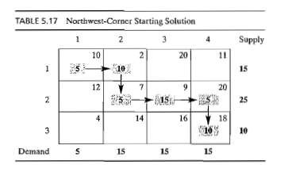
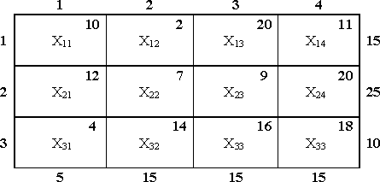
Northwest Corner Method (Example)
Solve the following transportation problem:
Supply
Demand
Starting basic solution is:
x₁₁ = 5, x₁₂ = 10, x₂₂ = 5, x₂₃ = 15, x₂₄ = 5, x₃₄ = 10
Total Transportation Cost = 5x10+10x2+5x7+15x9+5x20+10x18 = Rs. 520

Slide 11
Least-cost Method
Steps:
Select the cell having least cost in the transportation tableau for allocation. Tie is broken arbitrarily.
Allocate as much as possible to the selected cell and adjust the associated demand and supply by subtracting the allocated amount.
Cross out the row or column with zero supply or demand to indicate that no further allocation can be made in that row or column. If both row (supply) and column (demand) are turn out to zero simultaneously, cross out one only, and leave the other one uncrossed-out with zero supply or demand.
If exactly one row or column is left uncrossed out, stop. Otherwise, move to the next cell with the smallest cost from the remaining uncrossed out tableau.

Slide 12
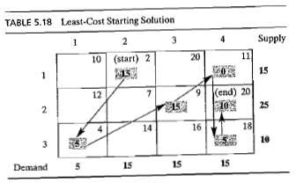
Least-cost Method (Example)
Solve the following transportation problem:
Supply
Demand
Starting basic solution is:
x₁₂ = 15, x₁₄ = 0, x₂₃ = 15, x₂₄ = 10, x₃₁ = 5, x₃₄ = 5
Total Transportation Cost = 15x2+0x11+15x9+10x20+5x4+5x18 = Rs. 475

Slide 13
Vogel’s Approximation Method (VAM)
Steps:
For each row (column), calculate penalty measure by subtracting the smallest cost element in that row (column) from the next smallest cost in the same row (column).
Identify the row or column with largest penalty. Tie is broken arbitrarily. Select the cell having least cost in the identified row or column for allocation. Tie is broken arbitrarily.
Allocate as much as possible to the selected cell and adjust the associated demand and supply by subtracting the allocated amount.
Cross out the row or column with zero supply or demand to indicate that no further allocation can be made in that row or column. If both row (supply) and column (demand) are turn out to zero simultaneously, cross out one only, and leave the other one uncrossed-out with zero supply or demand.
5. (a) If exactly one row or column is left uncrossed out, stop.
(b) If one row (column) with positive supply (demand) remains uncrossed out, allocate in the cells as per least-cost method in that row (column). Stop.
(c) If any uncrossed out row (column) has remaining zero supply (demand), allocate zero in the cells as per least-cost method in that row (column). Stop.
(d) Otherwise, go to step 1.

Slide 14
Vogel’s Approximation Method (Example)
Solve the following transportation problem:
Supply
Demand
 | 1 | 2 | 3 | 4 | Supply | Row Penalty
1 | 10 | 2 | 20 | 11 | 15 | 10-2=8
2 | 12 | 7 | 9 | 20 | 25 | 9-7=2
3 | 4 (5) | 14 | 16 | 18 | 10 5 | 14-4=10
Demand | 5 0 | 15 | 15 | 15
Column Penalty | 6 | 5 | 7 | 7
Highest

Slide 15
Vogel’s Approximation Method (Example)
 | 1 | 2 | 3 | 4 | Supply | Row Penalty
1 | 10 | 2 (15) | 20 | 11 | 15 0 | 11-2=9
2 | 12 | 7 | 9 | 20 | 25 | 9-7=2
3 | 4 (5) | 14 | 16 | 18 | 10 5 | 16-14=2
Demand | 5 0 | 15 0 | 15 | 15
Column Penalty | - | 5 | 7 | 7
Highest
 | 1 | 2 | 3 | 4 | Supply | Row Penalty
1 | 10 | 2 (15) | 20 | 11 | 15 0 | 20-11=9
2 | 12 | 7 | 9 (15) | 20 | 25 10 | 20-9=11
3 | 4 (5) | 14 | 16 | 18 | 10 5 | 18-16=2
Demand | 5 0 | 15 0 | 15 0 | 15
Column Penalty | - | - | 7 | 7
Highest

Slide 16
Vogel’s Approximation Method (Example)
 | 1 | 2 | 3 | 4 | Supply
1 | 10 | 2 (15) | 20 | 11 (0) | 15 0
2 | 12 | 7 | 9 (15) | 20 (10) | 25 10 0
3 | 4 (5) | 14 | 16 | 18 (5) | 10 5 0
Demand | 5 0 | 15 0 | 15 0 | 15 10 0
One column is uncrossed out. Make the allocation in this column as per least cost method.
Starting basic solution is:
x₁₂ = 15, x₁₄ = 0, x₂₃ = 15, x₂₄ = 10, x₃₁ = 5, x₃₄ = 5
Total Transportation Cost = 15x2+0x11+15x9+10x20+5x4+5x18 = Rs. 475

Slide 17
Transportation Algorithm
Determination of the Optimum Solution:
After determining the starting basic solution the following steps are used to get optimum solution:
Steps:
Use the optimality condition of the simplex method to determine the entering variable from among the non-basic variables. If the optimality condition is satisfied, stop. Otherwise, go to step 2.
Use the feasibility condition of the simplex method to determine the leaving variable from among the current basic variables and find the new basic solution. Return to step 1.
Methods for Optimum Solution:
Method of Multipliers / U-V Method/ MODI (Modified Distribution) Method
Stepping Stone Method

Slide 18
Method of Multipliers
Assign the multipliers u_{i} with row i and v_{j} with column j of the transportation tableau.
For each filled cell (current basic variable):
Develop the equations as per follows for each filled cell (basic variable):
u_{i} + v_{j} = c_{ij}
The number of filled cells is m+n-1, and number of multipliers is m+n. Set any one multiplier equal to zero and solve for the remaining variables.
For each empty cell (current non-basic variable):
∆_{ij} = u_{i} + v_{j} – c_{ij}
Select the non-basic variable with the largest positive coefficient (∆_{ij}) to be the entering variable. The solution is optimal if and only if all ∆_{ij} are non-positive.
Consider the same example for optimum solution.
Take starting solution obtained from Northwest Corner Method.

Slide 19
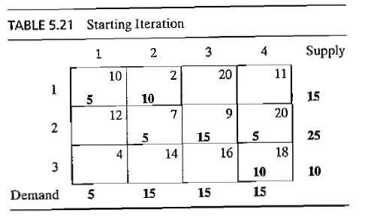
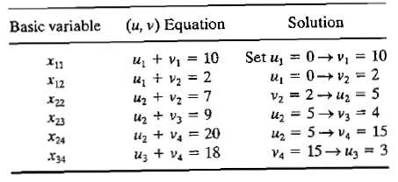
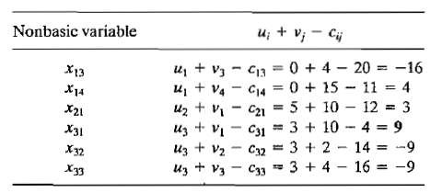
Method of Multipliers
From Filled Cells (basic variables):
Evaluation of u_{i} and v_{j}
From Empty Cells (Non-basic variables):
Evaluation of u_{i} and v_{j}
Most Positive

Slide 20
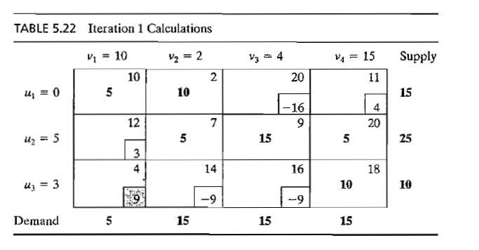
Method of Multipliers
For leaving variable:
Develop a closed loop that starts and ends at the entering variable cell. The loop consists of connected horizontal and vertical segments only (no diagonal are allowed). Except for the entering variable cell, each corner of the closed loop must coincide with the basic variable.
Entering variable

Slide 21
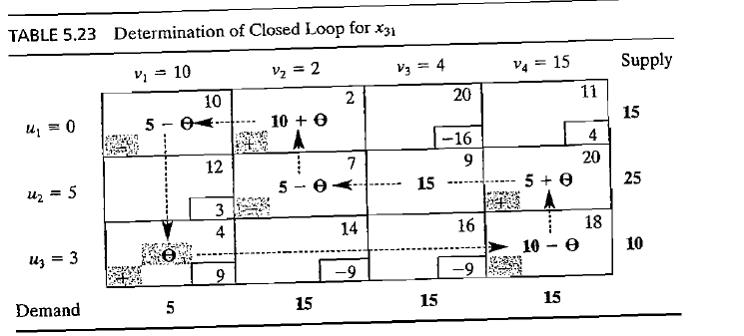
Method of Multipliers
x₁₁, x₂₂, and x₃₄ are the candidates for leaving variable.
Maximum value of ɵ is calculated in such a way that it should satisfy the following non-negative conditions:
x₁₁ = 5 - ɵ ≥ 0 x₂₂ = 5 - ɵ ≥ 0 x₃₄ = 10 - ɵ ≥ 0
The max. value of ɵ is 5. Both x₁₁ and x₂₂ reaches to zero level simultaneously. Select any one (say x₁₁) as the leaving variable.

Slide 22
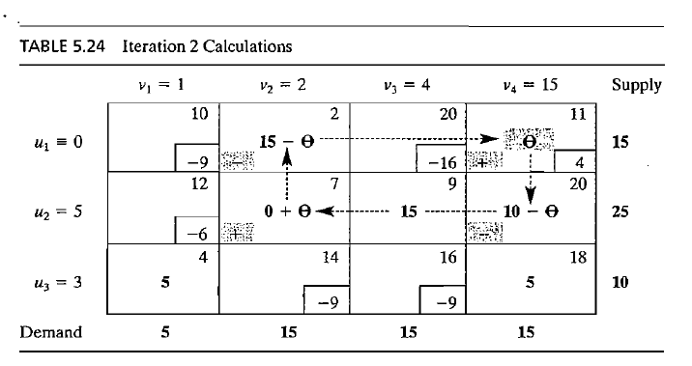
Method of Multipliers
Entering variable being most +ve
x₁₁, x₂₂, and x₃₄ are the candidates for leaving variable.
Maximum value of ɵ is calculated in such a way that it should satisfy the following non-negative conditions:
x₁₂ = 15 - ɵ ≥ 0 x₂₄ = 10 - ɵ ≥ 0
The max. value of ɵ is 10.
x₂₄ is the leaving variable.

Slide 23
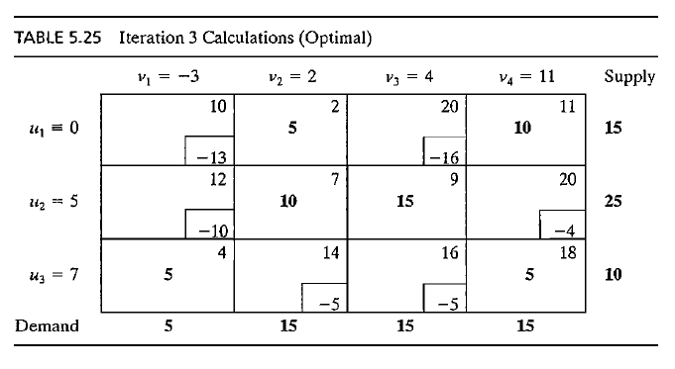
Method of Multipliers
The coefficients of all non-basic variables are non-positive (all ∆_{ij} are non-positive). Therefore, current solution optimum. The Optimum Solution is-
x₁₂ = 5, x₁₄ = 10, x₂₂ = 10, x₂₃ = 15, x₃₁ = 5, x₃₄ = 5
Total Transportation Cost = 5x2+10x11+10x7+15x9+5x4+5x18 = Rs. 435

Slide 24
Stepping-Stone Method
The name stepping-stone relates to an analogy of crossing a pond or stream by moving from stone to stone. In case of transportation solution the “stones” are the filled cells.
It provides an intuitive understanding of the evaluation process. When a solution is not optimal, the distribution plan must be revised by reallocating units into and out of various cells, only stepping-stone method can be used for reallocation.
The stepping-stone method involves tracing a series of closed paths in the transportation table, using one such path for each empty cell. The path represents a shift of one unit into an empty cell and it enables the analyst to assess the impact of such shifting on total cost. The method helps –
To identify the empty cell for shipping and associated cost reduction.
To calculate maximum number of units can be shifted into empty cell.
To reallocate the shipping units in other filled cells to compensate for the shift in empty cell.

Slide 25
Stepping-Stone Method
Steps of Stepping-stone Method.
Evaluate all empty cells one by one.
Trace a path that starts and ends at the empty cell being evaluated. It will consist only horizontal and vertical moves. Alternate move will take place from the filled cell. It is permissible to skip over some filled cells to find such a filled cell from where the path can continue.
Assign alternate + and – signs at each corner cell of the path starting with a + sign in the cell being evaluated.
Evaluate net change in the cost on the path by taking difference of sum of all the costs associated with the + sign and the sum of the costs associated with – sign. (consider the +ve cost of the cells assigned with + sign and –ve cost assigned with –ve sign).
Identify the empty cell that provides most negative net change in the cost is as entering cell. If no cell has the negative net change in the cost then current solution is optimum, stop. Otherwise, select the leaving cell on the path having least cost value assigned with – ve sign.
Allocate as much as possible in the entering cell and reallocate the units in other cells of the path keeping demand and supply unchanged. No allocation in the leaving cell.
Go to step 1.

Slide 26
Stepping-Stone Method (Example)
A real state company contracted three companies to supply cement for its three projects. The transportation tableau for the same is given below:
Starting Feasible Solution:
Use any one of the following method to get Starting Feasible Solution:
Northwest Corner Method
Least-cost Method
Vogel’s Approximation Method
To From | Project # 1 | Project # 2 | Project #3 | Supply
Plant A | 4 | 2 | 8 | 100
Plant B | 5 | 1 | 9 | 200
Plant C | 7 | 6 | 3 | 200
Demand | 50 | 150 | 300 | 500

Slide 27
Stepping-Stone Method (Example)
Starting Feasible Solution (Using Northwest Corner Method):
In the starting solution empty cells are A-3, B-1, C-1 and C-2.
All empty cells are to be evaluated one by one.
To From | Project # 1 | Project # 2 | Project #3 | Supply
Plant A | 4 (50) | 2 (50) | 8 | 100
Plant B | 5 | 1 (100) | 9 (100) | 200
Plant C | 7 | 6 | 3 (200) | 200
Demand | 50 | 150 | 300
Total Transportation Cost
= 50x4 + 50x2 + 1x100 + 9x100 + 3x200
= 1900

Slide 28
Stepping-Stone Method (Example)
Evaluation of the cell A-3:
To From | Project # 1 | Project # 2 | Project #3 | Supply
Plant A | 4 (50) | 2 (50) | 8 | 100
Plant B | 5 | 1 (100) | 9 (100) | 200
Plant C | 7 | 6 | 3 (200) | 200
Demand | 50 | 150 | 300
A-3
+ | -
8 | 2
1 | 9
+9 | -11
Net = -2
-
+
Net=-2, means allocation of one unit in the A-3 will decrease the total transportation cost by 2 per unit.
+
-

Slide 29
Stepping-Stone Method (Example)
Evaluation of the cell B-1:
To From | Project # 1 | Project # 2 | Project #3 | Supply
Plant A | 4 (50) | 2 (50) | 8 | 100
Plant B | 5 | 1 (100) | 9 (100) | 200
Plant C | 7 | 6 | 3 (200) | 200
Demand | 50 | 150 | 300
B-1
+ | -
5 | 4
2 | 1
+7 | -5
Net = +2
-
+
Net=+2, means allocation of one unit in the B-1 will increase the total transportation cost by 2 per unit.
+
-

Slide 30
Stepping-Stone Method (Example)
Evaluation of the cell C-1:
To From | Project # 1 | Project # 2 | Project #3 | Supply
Plant A | 4 (50) | 2 (50) | 8 | 100
Plant B | 5 | 1 (100) | 9 (100) | 200
Plant C | 7 | 6 | 3 (200) | 200
Demand | 50 | 150 | 300
C-1
+ | -
7 | 4
2 | 1
9 | 3
+18 | -8
Net = +10
-
+
Net=+10, means allocation of one unit in the C-1 will increase the total transportation cost by 10 per unit.
+
-
+
-

Slide 31
Stepping-Stone Method (Example)
Evaluation of the cell C-2:
To From | Project # 1 | Project # 2 | Project #3 | Supply
Plant A | 4 (50) | 2 (50) | 8 | 100
Plant B | 5 | 1 (100) | 9 (100) | 200
Plant C | 7 | 6 | 3 (200) | 200
Demand | 50 | 150 | 300
C-2
+ | -
6 | 1
9 | 3
+15 | -4
Net = +11
Net=+11, means allocation of one unit in the C-2 will increase the total transportation cost by 11 per unit.
+
-
+
-
There is only one cell, A-3, with negative cell value. Consider A-3 as the entering cell.
Leaving cell will be A-2 having least allocation among the –ve assigned cells.

Slide 32
Stepping-Stone Method (Example)
Revised Solution
Transportation Schedule:
From Plant A to Project 1 = 50 units
From Plant A to Project 3 = 50 units
From Plant B to Project 2 = 150 units
From Plant B to Project 3 = 50 units
From Plant C to Project 3 = 200 units
To From | Project # 1 | Project # 2 | Project #3 | Supply
Plant A | 4 (50) | 2 | 8 (50) | 100
Plant B | 5 | 1 (150) | 9 (50) | 200
Plant C | 7 | 6 | 3 (200) | 200
Demand | 50 | 150 | 300
Total Transportation Cost
= 50x4 + 50x8 + 150x1 + 50x9 + 200x3
= 1800
Decrease in cost = 100
To check the optimality we have to calculate again the cell values of all empty cells.
Cell values are: A-2: +2-8+9-1 = +2 B-1: +5-4+8-9 = 0
C-1: +7-4+8-3 = +8 C-2: +6-1+9-3 = 11
No cell has negative value, therefore, current solution is optimum.

Slide 33
Transportation Problem - Special Issues:
Alternate optimal solutions
Degeneracy
Unacceptable or Prohibited routes
Unbalanced Transportation problem
Maximization Transportation problem
Alternate Optimal Solutions:
Sometimes transportation problems have multiple optimal solutions. Alternate solution will be available without changing the total cost.
The existence of the alternate solutions is signaled by the zero value of the empty cell.

Slide 34
Transportation Problem - Special Issues:
2. Degeneracy:
Degeneracy occurs when no. of filled cells < m+n-1 (no. of rows + no. of columns – 1)
In case of degeneracy-
There will be at least one empty for which path (loop) cannot be traced.
All u_{i} and v_{j} cannot be evaluated.
Solution:
Place a delta (∆→0) in one of the empty cell to evaluate remaining cells.
Consider the following points as selection of empty cell to place delta is tricky:
Some empty cells may be unsuitable if they do not enable evaluation of the all remaining empty cells.
The delta cannot be placed in a cell that later turns out to be in a negative position of a path.

Slide 35
Transportation Problem - Special Issues:
3. Unacceptable or Prohibited Routes:
In some cases certain source-destination combinations may be unacceptable due weather factors, equipment breakdown, labour problem, etc.
To deal with such problem assign very-very high transportation cost in the concerned cell. As a thumb rule one can assign 100 times the largest cost in the table.
The prohibited route may appear in the non-optimal solution, but it will be eliminated by the time the optimal solution is reached.

Slide 36
Transportation Problem - Special Issues:
4. Unbalanced Transportation Problem:
If total demand is not equal to the total supply then the problem is unbalanced.
To get the solution we need balanced transportation problem.
To convert the unbalanced problem into balanced problem we should add a dummy source or a dummy destination in the problem.
Dummy source (row) should be added if supply is less.
Dummy destination (column) should be added if demand is less.
The supply (demand) of the dummy source (destination) will be equal to the difference of total demand and supply.
Cost entries in the dummy row or column can be taken as zero, if no such information is given.
If penalties are considered due to short or over supply then penalties should be taken as cost entries in the corresponding dummy row or column.

Slide 37
Transportation Problem - Special Issues:
5. Maximization Transportation Problem:
If the transportation tableau consists profits or revenues rather than costs then the objective will be maximization.
Such problems can be handled by adding one additional step at the start:
Identify the cell with the largest profit or revenue and subtract all the other cell profits from that value. The transportation table will be converted to the Opportunity Loss table and then the objective will be changed to minimization and methods of transportation models can be applied to solve.
After getting the optimal solution use the original cell values (profits) to compute the total profit.

Slide 38
Assignment Model
The assignment model is a special case of the transportation problem in which workers represent the sources and jobs represent the destinations. The supply amount at each source and demand at each destination is exactly equal to one.
Even the problem can be solved using Simplex method or Transportation model methods. But as the Assignment model has special structure, a new simpler method – Hungarian Method is developed for Assignment problems.
 | Job
Machine | 1 | 2 | 3 | 4
A | 1 | 4 | 6 | 3
B | 9 | 7 | 10 | 9
C | 4 | 5 | 11 | 7
D | 8 | 7 | 8 | 5

Slide 39
Assignment Model (Hungarian Method)
STEPS:
1. Row Reduction: Subtract least cost in each row from all costs in that row.
2. Column Reduction: Subtract least cost in each column from all costs in that column.
3. Draw the minimum number of horizontal and / or vertical lines to cross out all zeros. If minimum number of lines is equal to the number of rows, optimal assignment is possible and go to Step 5.
4. If minimum number of lines is less than the number of rows, identify the smallest uncrossed opportunity cost and subtract it from all uncrossed costs and add to the crossed costs that lie at the intersection of lines drawn to cross out zeros. Repeat Step 3.
5. Make the assignments. Begin with a row or column that has a single zero. Encircle that zero to indicate the assignment and cross the corresponding row and column for not considering further for assignment. Continue the process of searching row or column having single zero for assignment. If still multiple zero-costs exist, choose arbitrarily for assignment.

Slide 40
Assignment Model (Example)
Machine | Job
 | 1 | 2 | 3 | 4
A | 1 | 4 | 6 | 3
B | 9 | 7 | 10 | 9
C | 4 | 5 | 11 | 7
D | 8 | 7 | 8 | 5
Machine | Job |  |  |  | Row Min.
 | 1 | 2 | 3 | 4
A | 0 | 3 | 5 | 2 | p₁=1
B | 2 | 0 | 3 | 2 | p₂=7
C | 0 | 1 | 7 | 3 | p₃=4
D | 3 | 2 | 3 | 0 | p₄=5
Row Reduction
Optimality Check
Column Reduction
Machine | Job |  |  |  | Row Min.
 | 1 | 2 | 3 | 4
A | 0 | 3 | 2 | 2 | p₁=1
B | 2 | 0 | 0 | 2 | p₂=7
C | 0 | 1 | 4 | 3 | p₃=4
D | 3 | 2 | 0 | 0 | p₄=5
Col. Min. | q₁=0 | q₂=0 | q₃=3 | q₄=0
Machine | Job |  |  |  | Row Min.
 | 1 | 2 | 3 | 4
A | 0 | 3 | 2 | 2 | p₁=1
B | 2 | 0 | 0 | 2 | p₂=7
C | 0 | 1 | 4 | 3 | p₃=4
D | 3 | 2 | 0 | 0 | p₄=5
Col. Min. | q₁=0 | q₂=0 | q₃=3 | q₄=0
No. of Min. Lines=3, No. of Rows=4; Optimal Assignment is not Possible

Slide 41
Assignment Model (Example)
Machine | Job |  |  |  | Row Min.
 | 1 | 2 | 3 | 4
A | 0 | 3 | 2 | 2 | p₁=1
B | 2 | 0 | 0 | 2 | p₂=7
C | 0 | 1 | 4 | 3 | p₃=4
D | 3 | 2 | 0 | 0 | p₄=5
Col. Min. | q₁=0 | q₂=0 | q₃=3 | q₄=0
Machine | Job |  |  |  | Row Min.
 | 1 | 2 | 3 | 4
A | 0 | 2 | 1 | 1 | p₁=1
B | 3 | 0 | 0 | 2 | p₂=7
C | 0 | 0 | 3 | 2 | p₃=4
D | 4 | 2 | 0 | 0 | p₄=5
Col. Min. | q₁=0 | q₂=0 | q₃=3 | q₄=0
Further Reduction
Min. Uncrossed Cost (r₁) = 1
No. of Min. Lines=4, No. of Rows=4; Optimal Assignment is Possible
Optimal Assignment
Assign Machine A to Job 1, Cost = 1
Assign Machine B to Job 3, Cost = 10
Assign Machine C to Job 2, Cost = 5
Assign Machine D to Job 4, Cost = 5
Total Assignment Cost = 1+10+5+5 = Rs. 21
Sum of all pi, qi and ri
= (1+7+4+5)+(0+0+3+0)+1 = 17+3+1 = Rs. 21
Cross Check:
Total Assignment Cost = Sum of all p_{i}, q_{i} and r_{i} = Rs. 21
Machine | Job |  |  |  | Row Min.
 | 1 | 2 | 3 | 4
A |  | 2 | 1 | 1 | p₁=1
B | 3 | 0 |  | 2 | p₂=7
C | 0 |  | 3 | 2 | p₃=4
D | 4 | 2 | 0 |  | p₄=5
Col. Min. | q₁=0 | q₂=0 | q₃=3 | q₄=0
0
0
0
0

Slide 42
Assignment Model (Special Cases)
The number of rows does not equal the number of columns.
The problem involves maximization rather than minimization.
Certain matches are undesirable or not allowed.
Multiple optimal solutions exist.
1. The number of rows does not equal the number of columns
Dummy row should be added if number of rows is less.
Dummy column should be added if number of columns is less.
Cost entries in the dummy row or column can be taken as zero, if no such information is given.
Machine | Job
 | 1 | 2 | 3 | 4
A | 15 | 19 | 12 | 16
B | 23 | 21 | 18 | 17
C | 20 | 16 | 11 | 19
Add Dummy Row
Machine | Job
 | 1 | 2 | 3 | 4
A | 15 | 19 | 12 | 16
B | 23 | 21 | 18 | 17
C | 20 | 16 | 11 | 19
D | 0 | 0 | 0 | 0

Slide 43
Assignment Model (Special Cases)
2. The problem involves maximization rather than minimization
If the assignment table consists profits or revenues rather than costs then the objective will be maximization.
Such problems can be handled by adding one additional step at the start - Identify the largest value in each column and then subtract all numbers in each column from the column maximum.
The assignment table will be converted to the Opportunity Loss table and then the objective will be changed to minimization.
In Opportunity Loss table Hungarian Method can be applied to get optimal assignment solution.
After getting the optimal solution use the original values (profits) to compute the total assignment profit.
3. Certain matches are undesirable or not allowed
A particular match or pairing may be either undesirable or otherwise unacceptable. To deal with such problem assign very high cost (say, M) in the concerned cost cell.
M will not be affected by any addition or subtraction. No assignment will take place in undesirable cell assigned with cost M.

Slide 44
Assignment Model (Special Cases)
4. Multiple optimal solutions exist
It can easily be recognized when making the optimal assignments:
No single zero will exist at some time, resulting in more than one choice for assignment and, hence, more than one optimal solutions.
All optimal solutions will have same total assignment cost.
Example-Final Assignment Table
Two Alternate Optimal Solutions
 | 1 | 2 | 3
A | 4
B |  | 3 | 2
C | 1
Assign Machine A to Job 2
Assign Machine B to Job 1
Assign Machine C to Job 3
Assign Machine A to Job 3
Assign Machine B to Job 1
Assign Machine C to Job 2
0
0
0
0
0
Total Assignment Cost will remain same in both cases

Slide 45
Thank You!
Dr. V.B.Gupta
+ 91 99933 50547
vbgupta.davv@gmail.com

